Slide 1

Retro Smash
In the partial Fulfillment of the Requirement
For the award of the
Bachelor of Information and Technology
Submitted by :
Deepak Shes BK
Pawan Thapa
Pravat Nagarkoti

Slide 2
Introduction
"Retro Smash " is a fun, nostalgic game where players use a paddle to bounce a ball and break bricks. With classic arcade-style graphics and gameplay, it offers a simple yet addictive experience perfect for casual gaming and reliving old-school fun.

Slide 3
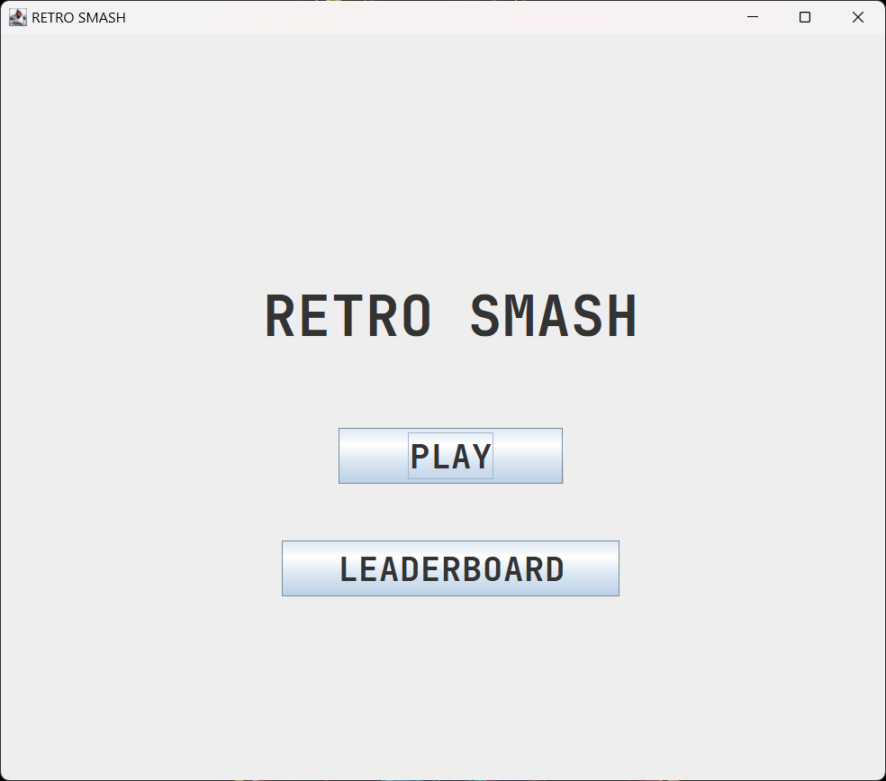
MENU

Slide 4
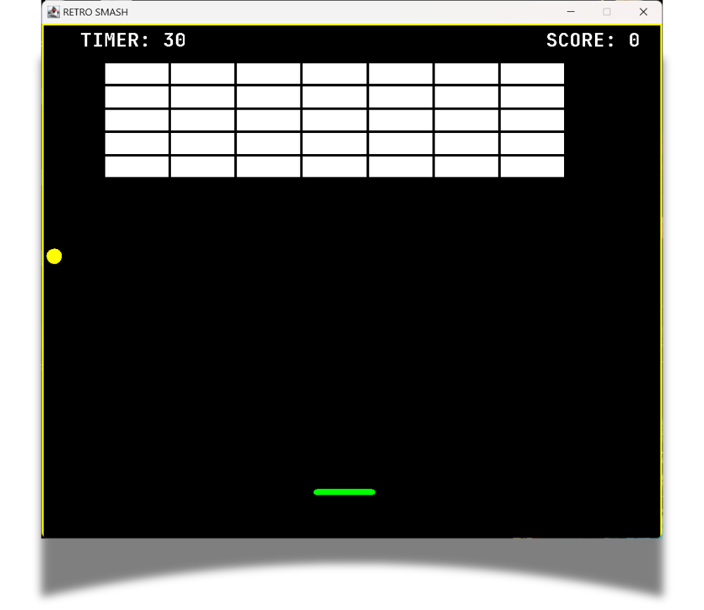
Game Play

Slide 5
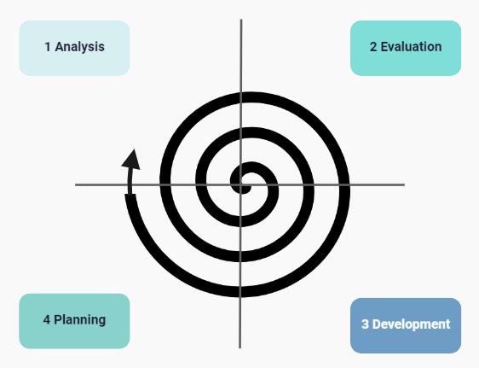
SPIRAL MODEL

Slide 6
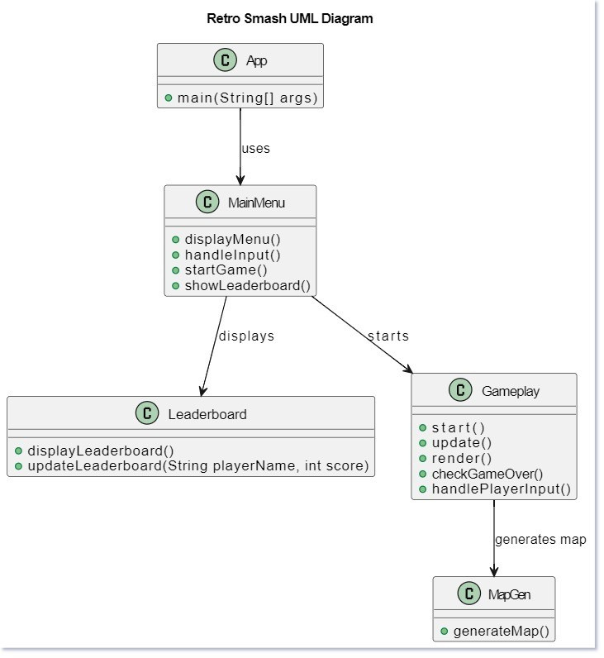

Slide 7
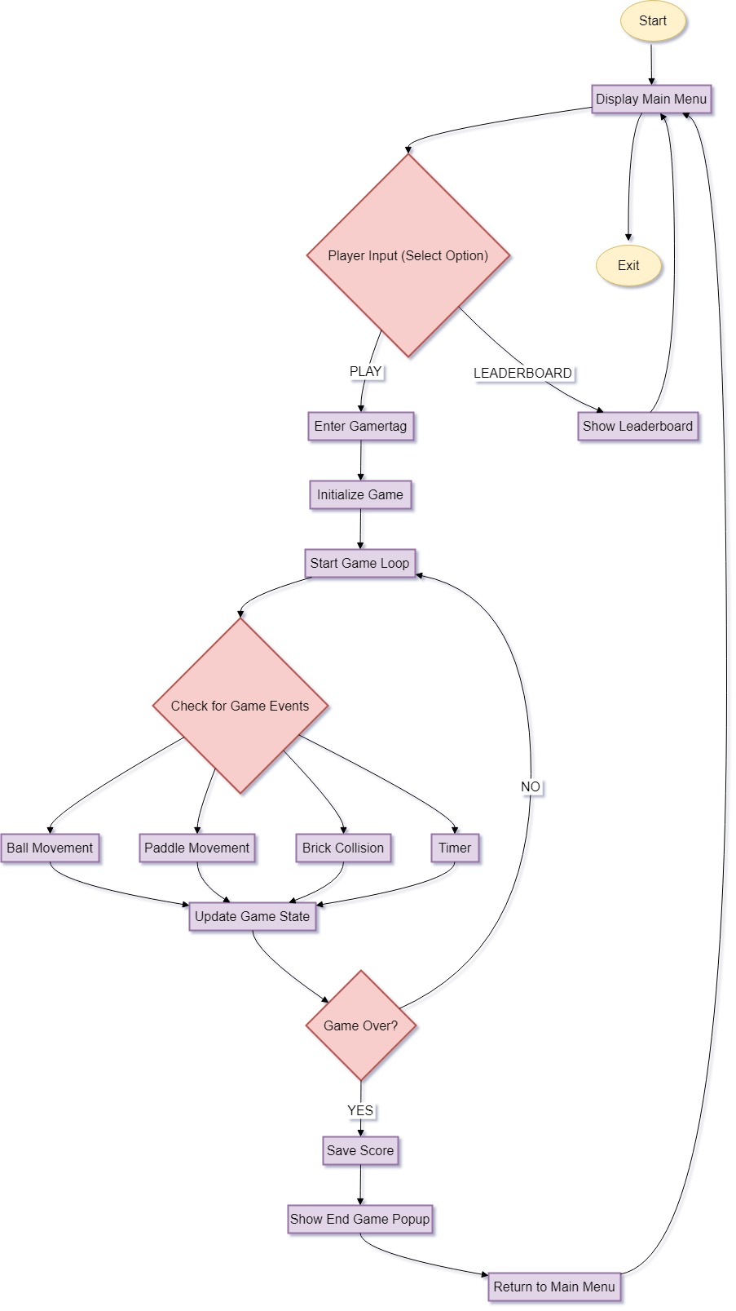
FlowChart

Slide 8
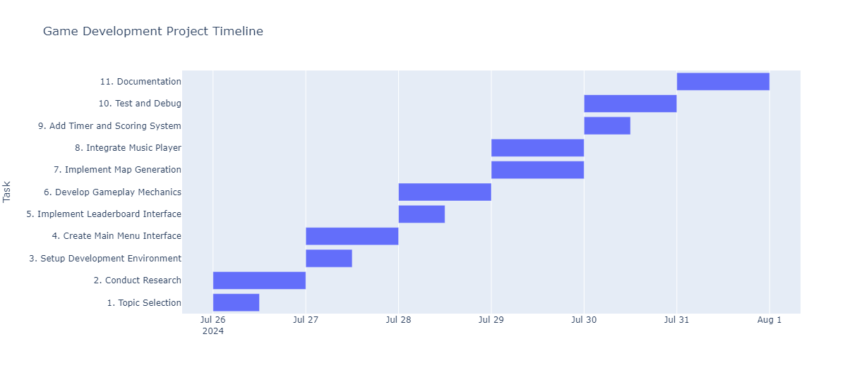

Slide 9
Future Enhancements
Multiplayer Mode: Introduce real-time competitive multiplayer gameplay.
Additional Levels and Power-Ups: Add new levels, special bricks, and power-ups.
Social Media Integration: Enable sharing of high scores and achievements on social media.
Improved Graphics: Enhance the visual appeal by using better graphics for bricks, paddles, and backgrounds, possibly through the use of a graphics library to create a more polished and modern look.

Slide 10
Conclusion
The retro smash break, a nostalgic revival of classic arcade gaming, serves as a testament to the timeless appeal of simple yet engaging gameplay. By incorporating vintage graphics, intuitive controls, and challenging levels, it successfully bridges the gap between past and present, allowing both seasoned gamers and newcomers to appreciate the charm of old-school gaming. This resurgence not only celebrates the history of the medium but also fosters a sense of community among players who share a love for the iconic games of yesteryears. Ultimately, the retro smash break reaffirms that the essence of gaming lies in the joy and excitement it brings, regardless of the era it originates from.

Slide 11
Game DEMO

